Slide 1
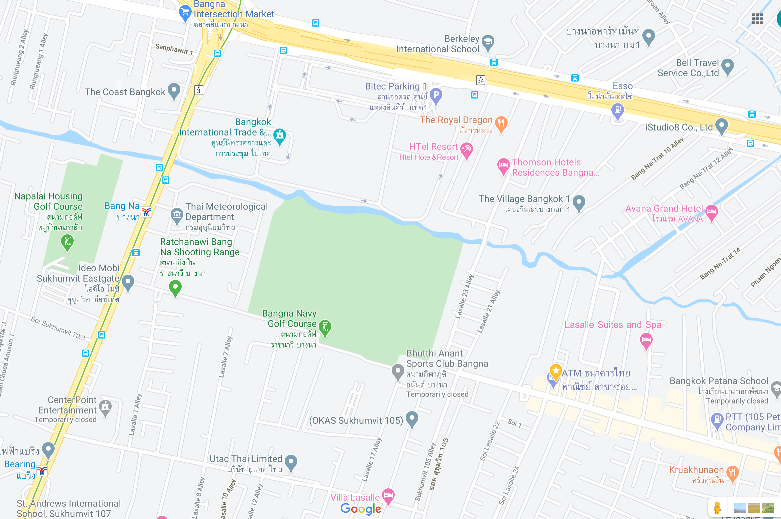
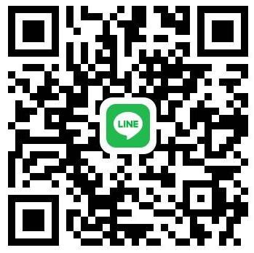
LOCATION & MAP
Gold Swim Academy
Gold Swim Academy’s Location: 477 Soi Sukhumvit 105
(Next to Soi La Salle 27), Bang Na, Bang Na, Bangkok 10260
GSA Parking
Parking
CONTACT US
Email: gorn@swim-academy.com Web: www.swim-academy.com
Squads & General Learn to Swim
Contact: +66 (0) 81 382 0153 Contact: +66 (0) 61 980 9855

